Slide 2
Mikael Nystrom
Whats up with Windows Server 2022?
Mikael.nystrom@truesec.se

Slide 3
What “new” really means
Jan 11, 2022 – WS2016 Mainstream End Date
Jan 9, 2024 – WS2019 Mainstream End Date
Including, containers, Azure IaaS, AWS, VM Sets, etc, etc, sigh…
Windows 10…30 months….

Slide 4
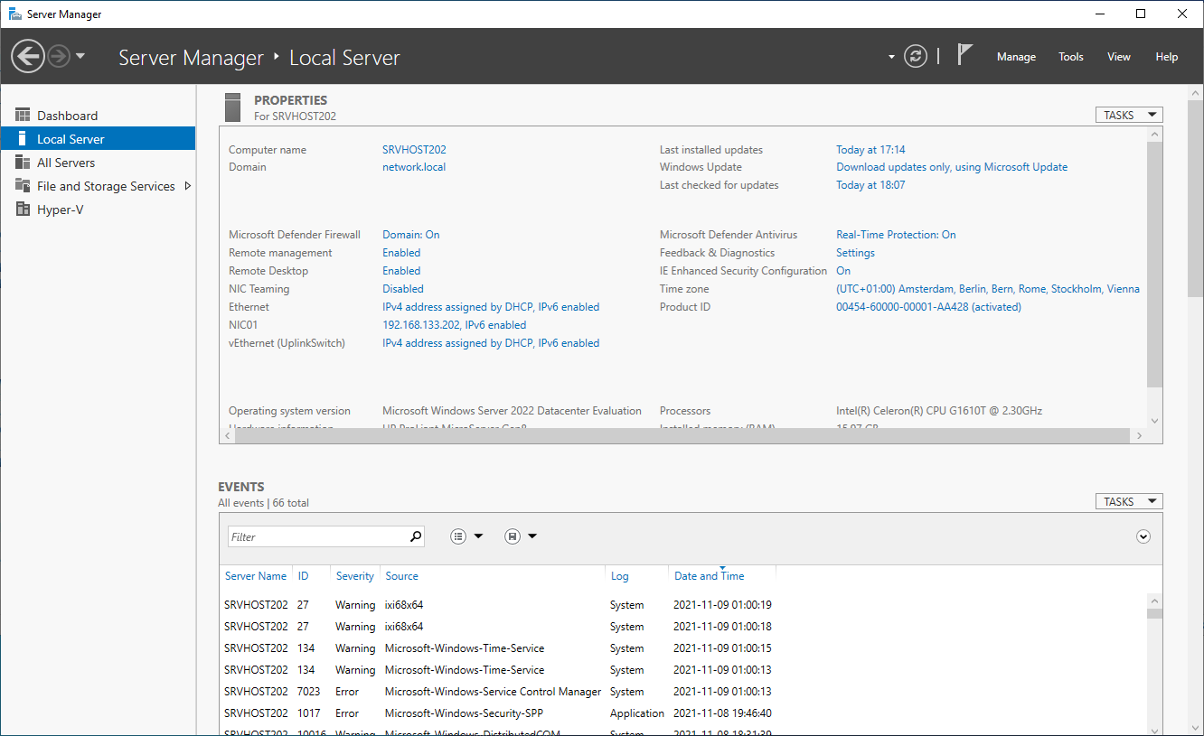
Windows Server 2022

Slide 5
This is gone…
Internet Explorer 11
PowerShell 2.0
The “real” Essentials

Slide 6
This is better
.Net framework is now 4.8
PowerShell 5.1 is defined and default
Max 48TB of RAM and 2048 LP’s
In 2019/2016 it was “only” 24TB of RAM and 512 LP’s
Server Core is 1GB smaller
gMSA for container identity without being domain joined

Slide 7
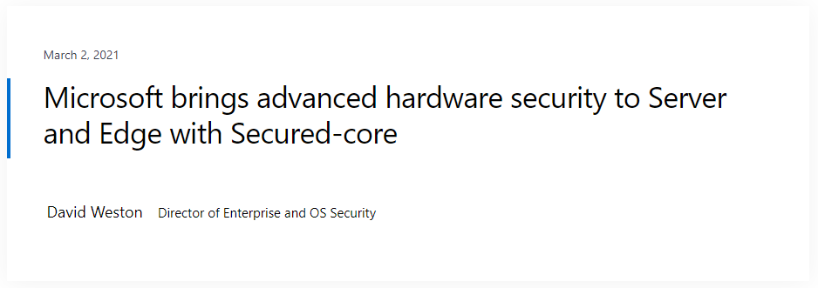
This is new and awesome
Secure Core Server
Hypervisor based code integrity (HVCI)
Boot DMA protection
System Guard
Secure Boot
VBS
TPM 2.0
You get directly from the vendor securely configured

Slide 8
Other cool stuff
SMB 3.1.1
AES-256-GCM and AES-256-CCM encryption can be used
RDMA traffic encryption can be encrypted
Granular control (north-south and east-west) can be on/off for each directly
SMB AES-128-GMAC Signing = It can now be used
TLS 1.3 is enabled by default
SMB Compression (robocopy /COMPRESS)
Nested virtualization for AMD processors

Slide 9
More cool stuff
UDP performance improvements
“UDP Segmentation Offload (USO). USO moves most of the work required to send UDP packets from the CPU to the network adapter's specialized hardware. Complimenting USO is UDP Receive Side Coalescing (UDP RSC), which coalesces packets and reduces CPU usage for UDP processing. In addition, we have also made hundreds of improvements to the UDP data path both transmit and receive. Windows Server 2022 and Windows 11 both have this new capability.”

Slide 10
More cool stuff
TCP performance improvements
“Windows Server 2022 uses TCP HyStart++ to reduce packet loss during connection start-up (especially in high-speed networks) and RACK to reduce Retransmit TimeOuts (RTO). These features are enabled in the transport stack by default and provide a smoother network data flow with better performance at high speeds. Windows Server 2022 and Windows 11 both have this new capability.”

Slide 11
The Hyper-V virtual switch
Virtual switches is updated with Receive Segment Coalescing (RSC).
This allows the hypervisor network to coalesce packets and process as one larger segment. CPU cycles are reduced, and segments will remain coalesced across the entire data path until processed by the intended application. This means improved performance in both network traffic from an external host, received by a virtual NIC, as well as from a virtual NIC to another virtual NIC on the same host.

Slide 12
Storage Migration Service in WS2022
Migrate local users and groups to the new server.
Migrate storage from failover clusters, migrate to failover clusters, and migrate between standalone servers and failover clusters.
Migrate storage from a Linux server that uses Samba.
More easily synchronize migrated shares into Azure by using Azure File Sync.
Migrate to new networks such as Azure.
Migrate NetApp CIFS servers from NetApp FAS arrays to Windows servers and clusters.

Slide 13
This could have been great, but
DNS over HTTPS (DoH)
But only as a client connecting to other DNS servers that supports DoH, since Windows Server 2022 DNS is not supporting it…

Slide 14
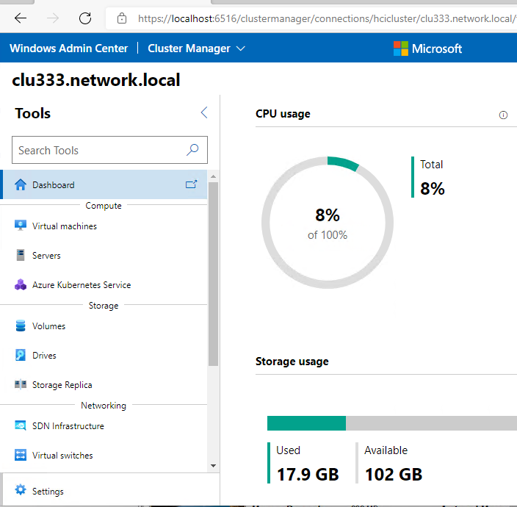
Hybrid is the way
Hyper-V is not dead, AzHCI is the focus
New “SKU”
Windows Server 2022: Azure Edition
Azure Extended Network
SMB over QUIC
Hotpatching
Note: Windows Server 2022: Azure Edition only runs in Azure and in AzHCI

Slide 15
Any new features in AD, CA, Print?
No…

Slide 16
Hardware - Minimum
CPU
1.4 GHz 64-bit processor
Compatible with x64 instruction set
Supports NX and DEP
Supports CMPXCHG16b, LAHF/SAHF, and PrefetchW
Supports Second Level Address Translation (EPT or NPT)
RAM
512 MB (2 GB for Server with Desktop Experience installation option)
ECC (Error Correcting Code) type or similar technology, for physical host deployments

Slide 17
Hardware - Minimum
Storage
Computers that run Windows Server must include a storage adapter that is compliant with the PCI Express architecture specification. Persistent storage devices on servers classified as hard disk drives must not be PATA. Windows Server does not allow ATA/PATA/IDE/EIDE for boot, page, or data drives. Size: Minimum: 32 GB

Slide 18
Hardware – what you need
CPU
Xeon Silver or better
(VM, at least 2 vcpu)
RAM
2GB or more, unless you are using it…
8GB if the computer is doing something, have Defender ATP, and/or other security features/apps installed/enabled
Disk
OS Disk at least 100GB

Slide 19
What you also need
UEFI
Secure Boot
TPM
BitLocker
Tiering
LAPS
Isolation
Applocker

Slide 20
SCOM
Enhanced Operations Manager RBAC
A new built-in role Read-only Administrator is supported. This role provides all the read permissions in Operations Manager including reporting.
You can create custom user roles with specific permissions. The Agent Management now supports two new subcategories - Deploy Agents and Repair Agents, that implicitly provide permission to Agent Pending Actions.
A new Delegated Administrator profile has been introduced, which is Read-Only Administrator except reporting. You can create a custom user role with Delegated Administrator as the base profile and add one or more permissions to it from the available categories.

Slide 21
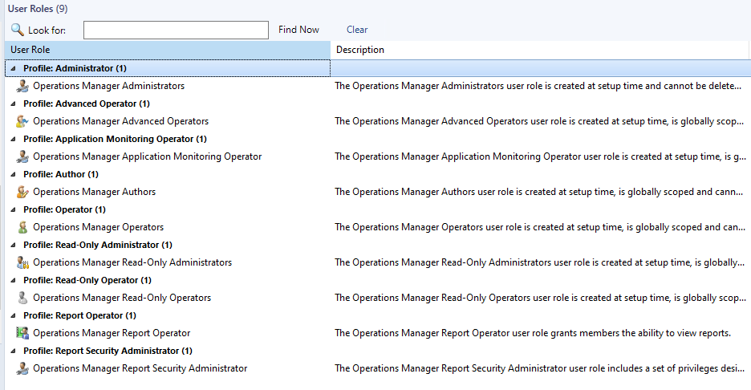

Slide 22
More…
Support for Reporting Services on NTLM hardened enterprises
For organizations with NTLM disabled, you can select the Reporting Manager Authentication Type as Windows Negotiate
Changes in Alert closure experience
Admin can opt to close an alert of a health monitor, which is in unhealthy state.
Create Operations Manager database on existing SQL Always On
You can set up and upgrade Operations Manager databases with an existing SQL Always-On setup without any need for post configuration changes.
SHA2 encryption for certificates
Uses SHA256.
Get Alert data via REST API scoped by Group
Supports groupId in Get Alert data API.
View source FQDN for alerts
You can view the source (FQDN) while tuning a management pack.
Sort option in Overrides summary
Supports sort option by column, in Overrides Summary.

Slide 23
More…
View alert source under active alerts
Supports the display of Alert source (monitor/rule) under Console > Monitoring > Active Alerts.
Removed dependency on LocalSystem account
LocalSystem is no longer used internally instead of the Default Action Account. This was used earlier for APM configuration, Privileged Monitoring Account, RunAs Profile fallback. There was an association created for the Validate Subscription Account RunAs Profile.
LocalSystem account is still being added to Operations Manager Administrators Group by Setup, but it is now visible in the console and can be removed and added later as required.
Folderization of Change Tracking Reports
Change tracking reports are available in one single folder by name Change Tracking.

Slide 24
A bit more
Supports .NET 4.8
PowerShell 3.0 version is the required minimum version.
You must install MSOLEDBSQL before you install Operations Manager.
Supports the following ”newer” browsers Chrome and Edge:
Internet Explorer version 11.
Microsoft Edge version 88 and later.
Google Chrome version 88 and later.
Supports Ubuntu 20, Oracle Linux 8, Debian 10, and Debian 11.
Removed support for AIX, Solaris, RHEL 5, RHEL 6, RHEL 7 (PPC), CentOS 6, Debian 8, SLES 11, and SLES 12 PPC.

Slide 25
SCVMM
Support for Windows Server 2022 as host and guest.
Supports for Windows 11 as guest.
Support for Azure Stack HCI clusters 21H2
Currently not “stretched”
Register and unregister Azure Stack HCI cluster using PowerShell cmdlets in SCVMM

Slide 26
Slides and demos from the conference will be available at
https://github.com/nordicinfrastructureconference/2022

